Slide 1
Presented by Abu Zakariya

Slide 2
Aims and Objectives
This training is not geared towards getting a quick Shahadah.

Slide 3
Aims and Objectives
Focus is on equipping you with the tools needed to tackle the fundamentals of Christianity.

Slide 4
Aims and Objectives
What you will learn is flexible enough to complement your existing dawah techniques.

Slide 5
Aims and Objectives
Move away from an over-reliance on the memorisation of Bible verses and instead will give you a firm grasp of the theology that underpins Christianity, insha’Allah.

Slide 6
What is Christianity?
How would you summarise Christian belief in a few short sentences?

Slide 7
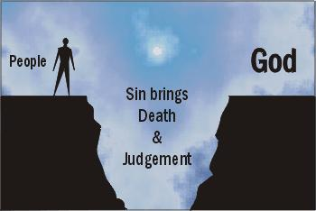
What is Christianity?
1. Sin has separated mankind from God.

Slide 8
What is Christianity?
2. Sin is like debt, it can't just be forgiven by God.

Slide 9
What is Christianity?
3. God sent His son, Jesus, to die for mankind.

Slide 10
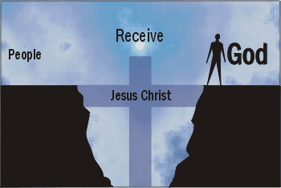
What is Christianity?
4. His sacrifice paid the penalty for our sins and redeems us in the sight of God.

Slide 11
Summary of Christian Belief
“Salvation is based on a belief of the deity of
Jesus and his death and resurrection.”

Slide 12
What is the Bible?
Depends on who you ask.

Slide 13
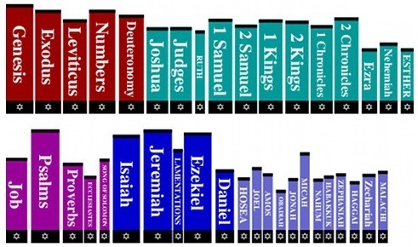
What is the Bible?
For Jews it’s the books of the Old Testament:

Slide 14
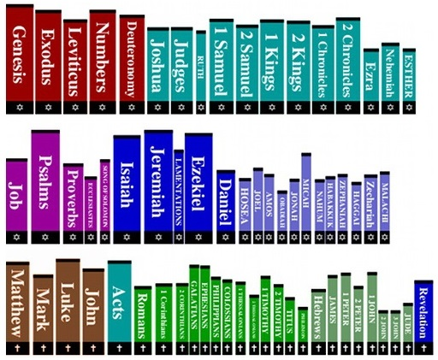
What is the Bible?
For Christians it’s the books of both the Old and New Testament:

Slide 15
What is the Bible?
It’s a compilation of books by different authors, spanning thousands of years and multiple genres.

Slide 16
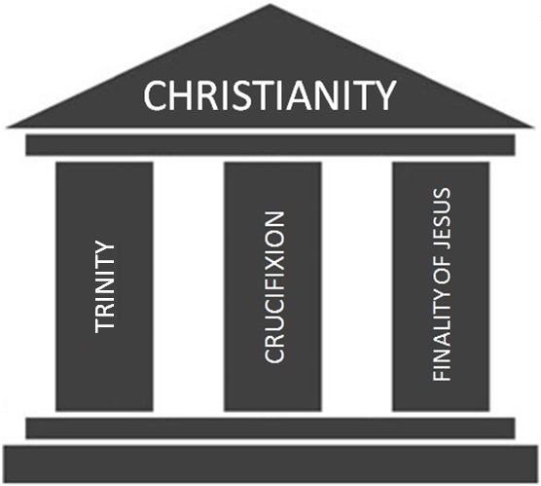
Foundations of Christianity

Slide 17
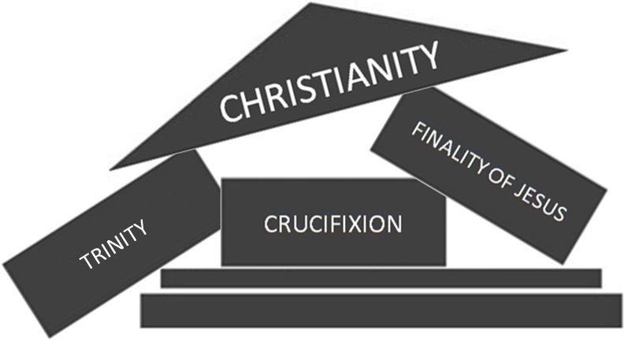
TRINITY

Slide 18
Agenda
We will focus on the Trinity and finality of Jesus in our training today.

Slide 19
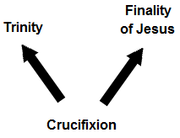
Agenda
Since the Crucifixion depends on the Trinity and finality of Jesus, tackling these two topics automatically dismantles the Crucifixion:

Slide 20
The Trinity

Slide 21
What is the Trinity?
How would you explain the doctrine of the Trinity in a few short sentences?

Slide 22
What is the Trinity?
The doctrine of the Trinity defines God as one being who eternally exists as three distinct Persons — the Father, Son and Holy Spirit.
Put simply, “one God in three persons”.

Slide 23
What is the Trinity?
All three Persons of the Trinity are said to be co-equal and co-eternal, and “each is God, whole and entire”.

Slide 24
What is the Trinity?
One “What” – God.
Three “Who’s” – Father, Son and Holy Spirit.

Slide 25
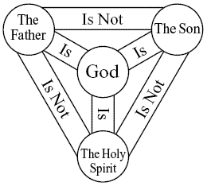
What is the Trinity?

Slide 26
In God’s plan of salvation for mankind, the persons have each taken on different roles:
The Father sent the Son
The Son redeems us by dying on the cross
The Holy Spirit inspires believers

Slide 27
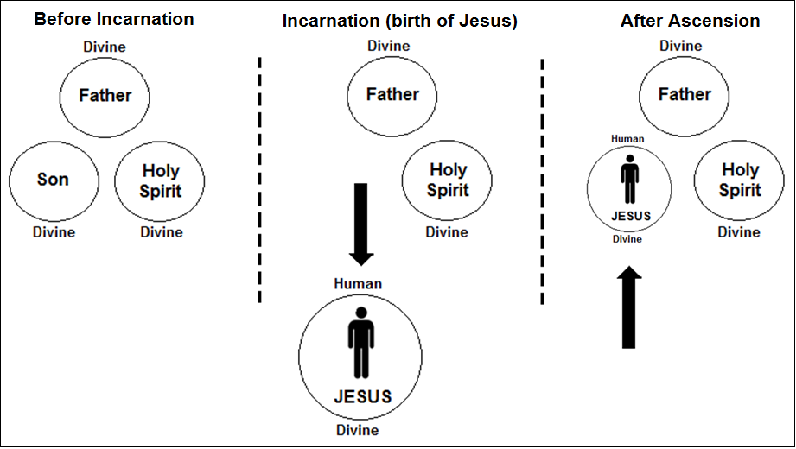
The Incarnation of Jesus

Slide 28
The Incarnation of Jesus
Thus the Son, Jesus, is now the god-man, he has two natures – one divine, one human.
Humanity has been permanently incorporated
into the Godhead. The Son will forever have an inseparable divine and human nature.

Slide 29
Approach to the Trinity
Tackle fundamentals rather than specific verses.
We can use some Qur’anic principles as discussion points for dawah. We will highlight issues with their beliefs and offer them something better, Islam.

Slide 30
Principles of Belief
1. The purpose of revelation is guidance.
“And We have sent down to you the Book as clarification for all things and as guidance...” [16:89]

Slide 31
Principles of Belief
2. Our beliefs about the unseen should derive from revelation.
That is from the news of the unseen which We reveal to you, [O Muhammad]. You knew it not, neither you nor your people, before this... [11:49]

Slide 32
Principles of Belief
3. Our interpretation of revelation should be consistent.
“As for those in whose hearts is deviation [from truth], they will follow that of it which is unspecific, seeking discord and seeking an interpretation [suitable to them]...” [3:7]

Slide 33
Principles of Belief
4. Our interpretation of revelation should not cause contradictions.
“Then do they not reflect upon the Qur'an? If it had been from [any] other than Allah, they would have found within it much contradiction.” [4:82]

Slide 34
Principles of Belief
5. We throw out man made religion.
“And when it is said to them, "Follow what Allah has revealed," they say, "Rather, we will follow that which we found our fathers doing." Even though their fathers understood nothing, nor were they guided?” [2:170]

Slide 35
Summary of Principles
1. The purpose of revelation is guidance.
2. Our beliefs about the unseen should derive from revelation.
3. Our interpretation of revelation should be consistent.
4. Our interpretation of revelation should not cause contradictions.
5. We throw out man made religion.

Slide 36
Principle #1
“The purpose of revelation is guidance”

Slide 37
What is Revelation?
Books of God revealed as guidance.
If guidance results in confusion (or misguidance) then it defeats the purpose of revelation!

Slide 38
Trinity is a Mystery
Many theologians have resigned themselves to classifying the Trinity as a holy mystery. The Catholic Church states the following:
The mystery of the Most Holy Trinity is the central mystery of Christian faith and life. [1]

Slide 39
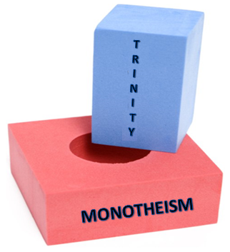
Why So Confusing?
The Trinity is inexplicable because Christians
try to put a doctrine of “threeness” into a purely monotheistic context which does not fit.

Slide 40
A Mystery, Yet Essential
Rejecting any aspect of the doctrine is enough for a Christian to be condemned as a disbeliever.
The evangelical scholar Harold Lindsell and professor Charles Woodbridge wrote the following:
“The mind of man cannot fully understand the mystery of the Trinity. He who has tried to understand the mystery fully will lose his mind; but he who would deny the Trinity will lose his soul.” [2]

Slide 41
A Mystery, Yet Essential
This shows a fundamental paradox with the doctrine: why would God reveal something that cannot be fully comprehended, and yet tie our salvation to it?

Slide 42
Conflicts with Purpose of Revelation
What should we make of all this in light of the purpose of revelation?
Revelation is an opening up, an uncovering. The most learned of biblical scholars admit the Trinity is a mystery, which directly conflicts with the very purpose of revelation: guidance.

Slide 43
Tawheed
Unlike the Trinity, the concept of God being one distinct and unique personality is easy to grasp by anyone, whether child or adult, from the lay person to the scholar.

Slide 44
Tawheed
Let’s examine some reasoning that God gives to explain why Jesus cannot have been divine:
The Messiah, son of Mary, was not but a messenger; [other] messengers have passed on before him. And his mother was a supporter of truth. They both used to eat food. Look how We make clear to them the signs; then look how they are deluded. [5:75]

Slide 45
Tawheed
Notice how God refers to Jesus as “son of Mary”. This phrase is repeated throughout the Qur’an and reinforces the idea that he is a very human messenger and not divine.
The mention of Jesus eating food is a simple but profound point, anything that needs sustenance cannot be God.

Slide 46
Tawheed
The Qur’an doesn’t rely on complicated arguments when addressing its reader, it is accessible to anyone regardless of age, intelligence and social background.

Slide 47
The Trinity
This is the opposite of the situation with Trinitarians. They are in the awkward position of having to believe in something that cannot be comprehended, which creates tension between the heart and mind. Thus they can never truly be at peace.

Slide 48
Tawheed
Tawheed, the pillar of Islam, is something that can be grasped by anyone. The believing Muslim has an inner peace that the Trinitarian cannot attain.

Slide 49
Tawheed
It’s interesting that one of the root meanings of the Arabic word ‘Islam’ is in fact “peace” – in essence Islam means “the attainment of peace by submitting to our Creator”.
The Qur’an describes this peace that Muslims have when they remember God:
Verily, in the remembrance of Allah do hearts find rest [13:28]

Slide 50
Principles Progress
1. The purpose of revelation is guidance.
2. Our beliefs about the unseen should derive from revelation.
3. Our interpretation of revelation should be consistent.
4. Our interpretation of revelation should not cause contradictions.
5. We throw out man made religion.

Slide 51
Principle #2
“Our beliefs about the unseen should derive
from revelation”

Slide 52
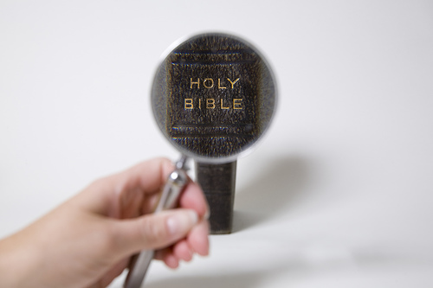
Trinity mentioned by name?
The term ‘trinity’ is not found anywhere in the Bible. Such terminology appears only in the writings of Church fathers much later.

Slide 53
Trinity mentioned by name?
The position of the Roman Catholic Church is that the term ‘trinity’ was first mentioned late into the second century:
In Scripture there is as yet no single term by which the Three Divine Persons are denoted together…The word trias (of which the Latin trinitas is a translation) is first found in Theophilus of Antioch about A.D. 180… [3]

Slide 54
Fabrications in the New Testament
Now, there is a mention of “threeness” in some versions of the Bible in a verse known as the Johannine Comma:
“For there are three that bear record in heaven, the father, the word, and the Holy Ghost: and these three are one” [1 John 5:7]

Slide 55
Fabrications in the New Testament
This verse used to be in all Bibles; however modern versions such as the Revised Standard Version (RSV) and New International Version (NIV) have removed it.

Slide 56
Fabrications in the New Testament

Slide 57
Fabrications in the New Testament
Here is the a footnote from the NIV regarding this verse:
Late manuscripts of the Vulgate testify in heaven: the Father, the Word and the Holy Spirit, and these three are one (not found in any Greek manuscript before the sixteenth century)

Slide 58
Fabrications in the New Testament
In other words, it is a fabricated verse that was inserted into the New Testament over 1,500 years after Jesus.

Slide 59
Fabrications in the New Testament
Trinitarians should reflect on this point: why is the only explicit mention of God being three, a later fabrication?

Slide 60
Fabrications in the New Testament
Clearly, it had to be inserted into the Bible to lend support for the doctrine because it is unbiblical.

Slide 61
Is Trinity Concept Present?
Trinitarians may try to argue that although there isn’t any mention of the word ‘trinity’ in the Bible, the concept is present throughout scripture.

Slide 62
Is Trinity Concept Present?
Let’s look at some examples of proof texts that are commonly put forward by Trinitarians…

Slide 63
Is Trinity Concept Present?
What do you think, are these valid proofs for the Trinity:
In the beginning was the Word, and the Word was with God, and the Word was God. [John 1:1]
For in him [Jesus] dwelleth all the fullness of the Godhead bodily. [Colossians 2:9]
Therefore go and make disciples of all nations, baptizing them in the name of the Father and of the Son and of the Holy Spirit [Matthew 28:19]

Slide 64
Refuting Trinity “Proof Texts”
There are simple techniques you can use to refute any claim of a Trinity proof text…

Slide 65
Refuting Trinity “Proof Texts”
Show another quote by the same author which challenges the Trinity.
Point out that their quote is inadequate in supporting the Trinity as it is believed in today.

Slide 66
Refuting Trinity “Proof Texts”
Let’s apply these techniques to the so-called proof texts we saw from earlier.

Slide 67
1. Fighting Quotes With Quotes
So-called proof text:
In the beginning was the Word, and the Word was with God, and the Word was God.
[John 1:1]
Our response:
After Jesus said this, he looked toward heaven and prayed: “Father... Now this is
eternal life: that they know you, the only true God, and Jesus Christ,
whom you have sent. [John 17:1-3]
Jesus said, “Do not hold on to me, for I have not yet ascended to the Father. Go
instead to my brothers and tell them, ‘I am ascending to my Father and your Father,
to my God and your God.’” [John 20:17]
Conclusion: Is John concrete evidence for the Trinity? No.

Slide 68
1. Fighting Quotes With Quotes
So-called proof text:
For in him [Jesus] dwelleth all the fullness of the Godhead bodily.
[Colossians 2:9]
Our response:
“and to know this love that surpasses knowledge—that you may be filled to
the measure of all the fullness of God”. [Ephesians 3:19]
But I want you to realize that the head of every man is Christ, and the head
of the woman is man, and the head of Christ is God. [1 Corinthians 11:3]
Conclusion: Is Paul concrete evidence for the Trinity? No.

Slide 69
1. Fighting Quotes With Quotes
So-called proof text:
Therefore go and make disciples of all nations, baptizing them in the
name of the Father and of the Son and of the Holy Spirit [Matthew 28:19]
Our response:
Then Jesus came to them and said, “All authority in heaven and on earth has been
given to me. [Matthew 28:18]
All things have been committed to me by my Father. No one knows
the Son except the Father, and no one knows the Father except the Son and
those to whom the Son chooses to reveal him. [Matthew 11:27]
Conclusion: Is Matthew concrete evidence for the Trinity? No.

Slide 70
1. Fighting Quotes With Quotes
Christians usually quote from John or Paul in order to prove the Trinity from the Bible.
So you don’t need to memorise every single proof text and its refutation, just one strong example from John and Paul.

Slide 71
2. Inadequate Proof Texts
This involves pointing out that their so-called proof texts fall short of supporting their beliefs about the Trinity:
“One God in three persons, Father, Son and Holy Spirit, all co-equal and co-eternal”

Slide 72
2. Inadequate Proof Texts
Since the Trinity is a fundamental belief in Christianity, it’s not unreasonable for us to request a clear statement from the Bible that comprehensively defines the doctrine of the Trinity as it is believed in today.

Slide 73
2. Inadequate Proof Texts
Does:
In the beginning was the Word, and the Word was with God, and the Word was
God. [John 1:1]
= ?

Slide 74
2. Inadequate Proof Texts
Does:
For in him [Jesus] dwelleth all the fullness of the Godhead bodily. [Colossians
2:9]
= ?

Slide 75
2. Inadequate Proof Texts
Does:
Therefore go and make disciples of all nations, baptizing them in the name of
the Father and of the Son and of the Holy Spirit [Matthew 28:19]
= ?

Slide 76
Concept Nowhere To Be Found
When Trinitarians try and argue for the divinity of Jesus as conclusive proof of the doctrine of the Trinity, they miss a big point...

Slide 77
Concept Nowhere To Be Found
Even IF we grant the claim that there are some statements in the New Testament which can be interpreted to imply that Jesus is divine in some capacity, this is no way takes away from our main argument:

Slide 78
Concept Nowhere To Be Found
The simple fact is that nowhere in the Bible is there any explicit mention of a Trinitarian formula, the concept that God is three persons that are co-equal and co-eternal.
Nor is God ever spoken of using terms like ‘Being’ and ‘Persons’ which is the language used by Trinitarians.

Slide 79
Concept Nowhere To Be Found
The Trinity is supposed to be the central doctrine of Christianity and the true nature of God, and yet the Bible does not clearly support it.

Slide 80
Concept Nowhere To Be Found
Often such proofs involve a patchwork of verses – the cobbling together of unrelated bits and pieces of scripture from across the Bible.

Slide 81
Concept Nowhere To Be Found
If this doctrine is so important then shouldn’t it be clearly explained all over the Bible, like other doctrines such as the death of Jesus for our sins and his resurrection from the dead?

Slide 82
Tawheed
Unlike the Trinity, the word Tawheed exists in our earliest sources:
“And your god is one [waahid] God…” [2:163]
“Some of the people of Tawheed will be punished in the Fire (on account of their sins) until they are coals. Then the Mercy (of God) will reach them, they will be taken out and tossed at the doors of Paradise.” He said: “The people of Paradise will pour water over them, and they will sprout as the debris carried by the flood sprouts, then they will enter Paradise.” [Tirmidhi, vol. 4, book 13, #2597]

Slide 83
Tawheed
Unlike the Trinity, the concept of Tawheed leaps out at you from every page of the Qur’an:
Say, “He is Allah, [who is] One, Allah, the Eternal Refuge. He neither begets nor is born, Nor is there to Him any equivalent.”

Slide 84
Tawheed
Surah Ikhlas takes four lines, less than 20 words in the original Arabic, to spell out in crystal clear terms the nature of God, with more clarity than anything that Trinitarians can manufacture from the Bible.

Slide 85
Principles Progress
1. The purpose of revelation is guidance.
2. Our beliefs about the unseen should derive from Revelation.
3. Our interpretation of revelation should be consistent.
4. Our interpretation of revelation should not cause contradictions.
5. We throw out man made religion.

Slide 86
Principle #3
“Our interpretation of revelation should be
consistent”

Slide 87
The language of the Bible
When examining the Bible as a whole we find that the term “Son of God” is very common:
the son of Enosh, the son of Seth, the son of Adam, the son of God. [Luke 3:38]
I [David] will proclaim the LORD's decree: He said to me, "You are my son; today I have become your father. [Psalm 2:7]
Now there was a day when the sons of God came to present themselves before the LORD, and Satan came also among them. [Job 1:6]

Slide 88
The language of the Bible
Moreover many individuals are referred to as “God”:
Then the LORD said to Moses, "See, I have made you like God to Pharaoh, and your brother Aaron will be your prophet. [Exodus 7:1]
The god of this age has blinded the minds of unbelievers, so that they cannot see the light of the gospel that displays the glory of Christ, who is the image of God. [2 Corinthians 4:4]

Slide 89
The language of the Bible
Notice the inconsistency of Trinitarians, why interpret any such references to Jesus literally and all others (David, Moses, Angels etc.) as a metaphor?

Slide 90
The Paradox of the Old Testament
If we look to the New Testament, we find that Jesus was presented with numerous opportunities to spell out the doctrine of the Trinity in detail. The following example is perhaps the most noteworthy:

Slide 91
The Paradox of the Old Testament
One of the teachers of the law came and heard them debating. Noticing that Jesus had given them a good answer, he asked him, “Of all the commandments, which is the most important?”
“The most important one,” answered Jesus, “is this: ‘Hear, O Israel: The Lord our God, the Lord is one. Love the Lord your God with all your heart and with all your soul and with all your mind and with all your strength.’ The second is this: ‘Love your neighbour as yourself.’ There is no commandment greater than these.”
“Well said, teacher,” the man replied. “You are right in saying that God is one and there is no other but him. To love him with all your heart, with all your understanding and with all your strength, and to love your neighbour as yourself is more important than all burnt offerings and sacrifices.”
When Jesus saw that he had answered wisely, he said to him, “You are not far from the kingdom of God.” And from then on no one dared ask him any more questions. [Mark 12:28-34]

Slide 92
The Paradox of the Old Testament
By simply repeating the commandment about God being One, Jesus is re-affirming the Old Testament view of God’s purely monotheistic nature
The teachings of Jesus are inconsistent with Trinitarian interpretations of the Bible.

Slide 93
The Paradox of the Old Testament
This was the perfect opportunity for Jesus to correct the Jewish questioner’s misconceptions about God, if the Trinity is true.
Instead the exact opposite is the case, Jesus complemented the questioner (“You are not far from the kingdom of God”)!

Slide 94
The Paradox of the Old Testament
From this example it’s clear that Jesus followed in the footsteps of the Prophets of the Old Testament such as Abraham and Moses.
Core message was simple: there is one God Who is unlike His creation and He alone deserves our worship.

Slide 95
The Paradox of the Old Testament
Does it make sense that God would send countless Prophets, over a span of thousands of years, with a consistent message of pure monotheism, only to all of a sudden reveal that He is a Trinity, a radically different message which contradicts His previous Prophets' teachings?

Slide 96
The Paradox of the Old Testament
How do Trinitarians explain this juxtaposition between their beliefs and the Old Testament?

Slide 97
The Paradox of the Old Testament
They claim that God reveals Himself gradually in stages; this is known as the concept of “Progressive Revelation”.
This is the idea that the sections of the Bible that were written later contain a fuller revelation of God compared to the earlier sections. So the New Testament is to be used to better understand and interpret the Old Testament.

Slide 98
Such an explanation must be rejected because the progression from a purely monotheistic concept of God Who is unlike His creation, to the Trinity where God becomes His creation, is anything but gradual.
Rather it is a radical overhaul of everything that came before it.

Slide 99
Another problem with this explanation is that the Trinitarian concept of God’s nature is open to development. When Trinitarians say that God exists as multiple persons, how do they know to stop at three, why not four or five?
At best they can say that only three persons have revealed themselves so far. But how do you know there isn't a fourth waiting to reveal themself?

Slide 100
Thus the Trinitarian can never lay claim to having an accurate understanding of God, because they can never be certain that God won’t reveal something in the future that radically overhauls their current understanding.

Slide 101
Tawheed
It’s important to reiterate that the Jewish understanding of the Old Testament commandments rejects all notions of God being a Trinity.
Islamic Tawheed is consistent with the Jewish concept of God.

Slide 102
Tawheed
In fact Rabbis state that if a Jew cannot find a synagogue to worship in, then it is permissible for them to pray in a mosque. They recognise that mosques are places of pure monotheism.
By comparison, Jews are discouraged from praying in Churches, some Rabbis rule that it’s forbidden to even set foot in them.

Slide 103
Tawheed
Like any religious book, the Qur’an has a scope of interpretation.
However, the Qur’an is unique in the sense that the scope of interpretation is very small because we have the Sunnah which explains the Qur’an in detail:
[We sent them] with clear proofs and written ordinances. And We revealed to you the message that you may make clear to the people what was sent down to them and that they might give thought. [16:44]

Slide 104
Principles Progress
1. The purpose of revelation is guidance.
2. Our beliefs about the unseen should derive from Revelation.
3. Our interpretation of revelation should be consistent.
4. Our interpretation of revelation should not cause contradictions.
5. We throw out man made religion.

Slide 105
Principle #4
“Our interpretation of revelation should not
cause contradictions”

Slide 106
Trinity Conflicts with the New Testament
The New Testament mentions an incident with Jesus and a fig tree:
Jesus was hungry. Seeing in the distance a fig tree in leaf, he went to find out if it had any fruit. When he reached it, he found nothing but leaves, because it was not the season for figs. Then he said to the tree, “May no one ever eat fruit from you again...” [Mark 11:12-14]

Slide 107
Trinity Conflicts with the New Testament
We are told that Jesus approached a fig tree because he was hungry, and became angry and cursed it when he realised it had no fruit.

Slide 108
Trinity Conflicts with the New Testament
Such an incident makes no sense in light of the Trinitarian claim that Jesus is fully God.
God is All Knowing, so if Jesus really is God then that would make him the creator of fig trees, in which case how could he have been ignorant of the fact that it was not the season for figs?

Slide 109
Trinity Conflicts with the New Testament
Why would God curse the fig tree for producing fruit in certain seasons, something He Himself willed it to do?
If Trinitarians want to argue that it was the limited human nature that made the mistake, then why did the divine nature act on the mistake of the human nature? Is this a case of the human nature overriding the divine nature? Is such a thing possible?

Slide 110
Trinity Conflicts with the New Testament
The miracles of Jesus, Trinitarians say, are because of his divine nature. In which case one has to ask the question of why the divine Jesus cursed the tree. Why not just command it to bear fruit? Why ruin a perfectly good tree, come fig season this tree would have had fruit and others could have eaten from it.

Slide 111
Trinity Conflicts with the New Testament
The fig tree story demonstrates that when it comes to the knowledge of Jesus, it seems that either the divine nature is lacking or completely absent.
Jesus cannot said to be fully God because he lacks essential attributes of God, such as possessing All Knowledge.

Slide 112
Trinity Conflicts with the New Testament
Such incidents bring to light the many contradictions of Trinitarian doctrine.
For example, how can God be All Powerful and yet have weaknesses such as hunger?

Slide 113
Trinity Conflicts with the New Testament
Moreover such divine shortcomings aren't just restricted to Jesus. The Bible tells us that the Holy Spirit also lacks God's perfect knowledge:
“But about that day or hour no one knows, not even the angels in heaven, nor the Son, but only the Father.” [Mark 13:32]

Slide 114
Trinity Conflicts with the New Testament
Here Jesus categorically states that no one, which includes himself and the Holy Spirit, knows the Hour, but only the Father. Since they both lack the Father's knowledge, the Trinitarian claim that the Father, Son and Holy Spirit are equal is false.
The co-equality of the persons is a central pillar, without which the foundation of the Trinity comes crashing down.

Slide 115
Trinity Conflicts with God’s Nature
Bible says God is eternal and unchanging:
Every good and perfect gift is from above, coming down from the Father of the heavenly lights, who does not change like shifting shadows. [James 1:17]
Your throne is established from of old; you are from everlasting. [Psalm 93:2]

Slide 116
Trinity Conflicts with God’s Nature
If the Son took on a dual nature, that is, a limited human nature alongside his divine nature, whilst at the same time still being God, then the implication is that in becoming man, the nature of God changed.
This conflicts with the knowledge from the Bible that God is eternal and unchanging.

Slide 117
God’s Perfection Compromised
Recall that at the incarnation humanity was been permanently incorporated into the Godhead. The Son will forever have an inseparable divine and human nature.

Slide 118
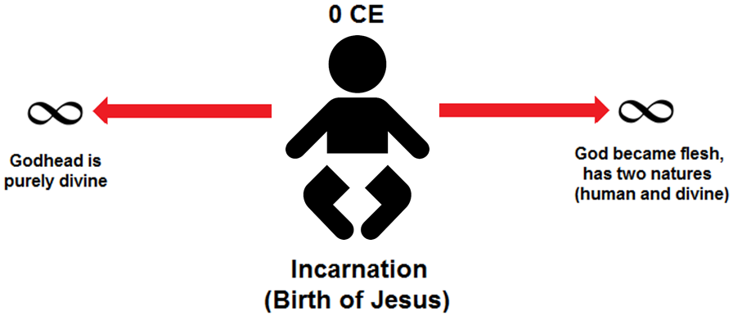
God’s Perfection Compromised
This raises an uncomfortable question: “Was God’s nature more perfect before or after the incarnation?”

Slide 119
God’s Perfection Compromised
Since God is the pinnacle of perfection, there is no need for Him to become anything. If something needs to be added to His nature, such as humanity or anything else for that matter, then doesn’t that mean He lacked something before?

Slide 120
God’s Perfection Compromised
Which state is considered more “godly”, the pre-incarnation God, or post-incarnation God? You can see that the doctrine of the incarnation puts Trinitarians in a blasphemous predicament.

Slide 121
The Qur’an
Let us consider the nature of the revelation of the Qur’an:
Revealed to a man who could neither read nor write.
Revealed piecemeal over a period of 23 years.
Surahs were not revealed sequentially. Al-Baqarah, for example, was revealed over many years, with its verses interspaced with the revelation of verses from other Surahs.
Many verses were revealed in response to unexpected questions and situations that Prophet Muhammad (pbuh) faced.
The Qur’an did not undergo an editorial process, once the verses were revealed their positions within Surahs were immediately fixed.
The Qur’an was an oral tradition, so its verses had to be recalled from memory. There was no written mushaf that could be consulted when “updating” the Qur’an with new verses.

Slide 122
The Qur’an
In spite of these difficult circumstances, the Qur’an is internally harmonious and presents the reader with a consistent theology. Moreover it does not contain any contradictions.

Slide 123
Principles Progress
1. The purpose of revelation is guidance.
2. Our beliefs about the unseen should derive from Revelation.
3. Our interpretation of revelation should be consistent.
4. Our interpretation of revelation should not cause contradictions.
5. We throw out man made religion.

Slide 124
Principle #5
“We throw out man made religion”

Slide 125
Our Discussion So Far...
The Trinity is not scriptural.
Not present in name or concept.
There are some verses which may support some aspects of the Trinity, but they are ambiguous at best.

Slide 126
The origins of the Trinity
So then, where did the Trinity come from?

Slide 127
The origins of the Trinity
We've already seen that terms like "son of God" were commonplace among Jews during the time of Jesus.

Slide 128
The origins of the Trinity
Recall that the Old and New Testaments are filled with such language:
the son of Enosh, the son of Seth, the son of Adam, the son of God. [Luke 3:38]
I [David] will proclaim the LORD's decree: He said to me, "You are my son; today I have become your father. [Psalm 2:7]
Now there was a day when the sons of God came to present themselves before the LORD, and Satan came also among them. [Job 1:6]

Slide 129
The origins of the Trinity
What we can conclude is that such language, although highly exalted, was commonplace and is intended figuratively, it is not an indication of divinity.

Slide 130
The origins of the Trinity
The disciples, the first believers in Jesus, were Jews.
In fact Christianity started out as a movement within Judaism.

Slide 131
The origins of the Trinity
Like Jews since the time of Moses, these first believers kept the Sabbath, were circumcised and worshiped in the Temple:
“One day Peter and John were going up to the temple at the time of prayer—at three in the afternoon.” [Acts 3:1]

Slide 132
The origins of the Trinity
The only thing that distinguished the early followers of Jesus from any other Jews was their belief in Jesus as the Messiah.

Slide 133
The origins of the Trinity
The turning point in history came when Christianity ceased being a small movement within Judaism and Gentiles (non-Jews) started to embrace the faith in large numbers.
We need to look to the pagan world of the Gentiles in order to understand the mind-set of the people that received the New Testament message.

Slide 134
The pagan world of the Gentiles
Since the time of Alexander the Great, Gentiles had been living in a Hellenistic (Greek) world.
The Roman Empire itself was heavily influenced by Hellenistic religion, philosophy and culture. Greek gods and goddesses like Zeus, Athena and Artemis dominated the landscape.

Slide 135
The pagan world of the Gentiles
Gentiles from a polytheistic background would have naturally understood Christian preaching about the "son of God" in light of a Greek or Roman god having been begotten by another.
We can see this mind-set manifested in the New Testament in an incident where Paul heals a crippled man:

Slide 136
The pagan world of the Gentiles
When the crowd saw what Paul had done, they shouted in the Lycaonian language, “The gods have come down to us in human form!”
Barnabas they called Zeus, and Paul they called Hermes because he was the chief speaker.
The priest of Zeus, whose temple was just outside the city, brought bulls and wreaths to the city gates because he and the crowd wanted to offer sacrifices to them. [Acts 14:11-13]

Slide 137
The pagan world of the Gentiles
This is not an isolated incident. We read elsewhere that Gentiles believed Paul was a god because he survived a bite from a venomous snake:

Slide 138
The pagan world of the Gentiles
Paul gathered a pile of brushwood and, as he put it on the fire, a viper, driven out by the heat, fastened itself on his hand.
When the islanders saw the snake hanging from his hand, they said to each other, “This man must be a murderer; for though he escaped from the sea, the goddess Justice has not allowed him to live.”
But Paul shook the snake off into the fire and suffered no ill effects.
The people expected him to swell up or suddenly fall dead; but after waiting a long time and seeing nothing unusual happen to him, they changed their minds and said he was a god. [Acts:28:3-6]

Slide 139
The pagan world of the Gentiles
With this background in mind, we can appreciate how Judaic phrases like “son of God” took on a different meaning when transported out of their Jewish monotheistic context into pagan Greco-Roman thought.

Slide 140
The pagan world of the Gentiles
It's easy to appreciate why Gentiles would see Jesus, an individual who performed miracles and was called the "Son of God", as more than a mere mortal.

Slide 141
The pagan world of the Gentiles
The Trinity doctrine arose neither in a vacuum, nor strictly from the text of scripture.
The Church emerged in a Jewish and Greek world and so the primitive Church had to reconcile the notions they had inherited from Judaism with those they had derived from pagan mythology.

Slide 142
The pagan world of the Gentiles
It’s interesting to note that the Greco-Roman religions were filled with tales of gods procreating with human beings and begetting god-men.
The belief that God could be incarnate, or that there were sons of God, were common and popular beliefs.

Slide 143
The pagan world of the Gentiles
For example, the chief god in the Greek pantheon, Zeus, visited the human woman Danae in the form of golden rain and fathered Perseus, a “god-man.”
In another tale Zeus is said to have come to the human woman Alcmena, disguised as her husband. Alcmena bore Hercules, another “god-man.”

Slide 144
The pagan world of the Gentiles
Such tales bear a striking similarity to Trinitarian beliefs of God being begotten as a man.
In fact, the early Christian apologist Justin Martyr, considered a saint in the Catholic Church, said the following in response to pagan criticisms that Christianity borrowed from their beliefs about the sons of God:

Slide 145
The pagan world of the Gentiles
"When we say that the Word, who is our teacher, Jesus Christ the first born of God, was produced without sexual union, and that he was crucified and died and rose again, and ascended to heaven, we propound nothing new or different from what you [pagans] believe regarding those whom you consider sons of Jupiter." [4]

Slide 146
The pagan world of the Gentiles
According to ancient Roman myth, Jupiter was the king of all the gods.
So here Justin Martyr is telling Roman pagans that what the Christians believe about Jesus being the son of God is no different to what they believe about the sons of the god Jupiter.

Slide 147
The pagan world of the Gentiles
Now that we have a basic background to the Greco-Roman world in which early Christianity arose, we can look to history to understand how the doctrine of the Trinity ultimately became victorious…

Slide 148
The Early church
One of the most fascinating discoveries by scholars in modern times has been the realisation of just how diverse the early Christian groups were from one another.

Slide 149
The Early church
Very early on in Christianity, almost from the get-go, different Christians in different churches in different regions had different views of Jesus:

Slide 150
1. Jesus was purely human
This is the view that Jesus was born purely a human being with no divine aspect whatsoever.
One such early Christian group were the Ebionites.
Jesus was the Son of God not because of his divine nature or virgin birth but because of his righteousness, God “adopted” Jesus to be his son.

Slide 151
2. Jesus was purely divine
Believed that Jesus had no human aspect at all and was purely divine.
Group of Christians known as the Marcionites.
Jesus did not have a flesh-and-blood body. He was not really human, he only appeared to be so.

Slide 152
3. Jesus was both human and divine
This is the view that Jesus had two natures, divine and human.
There were numerous sub-groups within this category:
1. Subordinationists believed that Jesus was divine and that he was created by God the Father, thus Jesus was not equal to the Father but subordinate to him.
2. Separationists believed that Jesus was always divine and that when Jesus became human he became an additional person. So Jesus existed as two beings, the man Jesus of Nazareth who was human and the Christ who was completely divine.
3. Proto-Trinitarians believed that Jesus was always divine and when he became human he took on an additional nature. So Jesus is one person with two natures, one divine and one human.

Slide 153
Orthodoxy Vs Heresy
The view of two natures became orthodoxy. Today it is the mainstream position in Catholicism, Protestantism and Eastern Orthodox Christianity.
The official position of these churches is that all the other groups, with their different views about Jesus, are heretics, deviations from the truth of the orthodoxy of Trinitarianism.

Slide 154
Orthodoxy Vs Heresy
Is it fair to casually dismiss these other views of Jesus as heretical?

Slide 155
Orthodoxy Vs Heresy
Trinitarians like to quote early Church Fathers like Tertullian (c. 155 – c. 240 CE) who spoke of a “trinitas” (Latin for ‘threeness’). They cite them as proof that the Trinity was the standard belief of Christians in the early church.

Slide 156
Orthodoxy Vs Heresy
However such claims are misleading. When we properly examine the writings of individuals like Tertullian we find that this is not the case:

Slide 157
Orthodoxy Vs Heresy
For the Father is the entire substance, but the Son is a derivation and portion of the whole, as He Himself acknowledges: “My Father is greater than I.” In the Psalm His inferiority is described as being “a little lower than the angels.” Thus the Father is distinct from the Son, being greater than the Son [5]

Slide 158
Orthodoxy Vs Heresy
Notice that Tertullian taught that the Father is greater than the Son.
In other words, one of the earliest sources in the Church who talks of a ‘trinity’ never actually taught a doctrine of three co-equal persons.

Slide 159
Orthodoxy Vs Heresy
By Trinitarian standards today, Tertullian is a heretic. In fact the Roman Catholic Church did condemn him as a heretic!
This demonstrates the foolishness of assigning labels like orthodox and heretic in the early church.

Slide 160
Orthodoxy Vs Heresy
If the Trinity is so clearly taught in the New Testament as Trinitarians claim, then why didn’t the greatest of Church fathers from the first three centuries hold to a modern Trinitarian view?

Slide 161
The Battle for Orthodoxy
We’ve seen that early Christianity was diverse.
Different groups engaged in a battle for dominance, leading to the victory of the one group that then successfully declared itself “orthodox”.

Slide 162
The Battle for Orthodoxy
The stakes are high. The group that emerged as victorious and declared itself orthodox would forever determine the shape of Christianity.
How Trinitarians came to be the dominant, orthodox group of Christianity today will now be our focus.

Slide 163
The Arian Controversy
In the early fourth century a debate raged within the Church with regards to the nature of Jesus.
Arius, a priest and theologian, and Bishop Athanasius, a Church Father, were the chief proponents of both sides of the debate.

Slide 164
The Arian Controversy
Arius promoted the idea that Jesus was in fact a creation of God and therefore inferior to God.
Athanasius promoted the idea that Jesus was equal to God.

Slide 165
The Arian Controversy
These disagreements about the nature of Jesus and his relationship to God deeply divided the Church in the Roman Empire.

Slide 166
The Council of Nicea – 325 CE
The Roman Emperor Constantine, seeking to unify the Church, convened the Council of Nicea in 325 CE.
The question to be settled was, “Is Jesus absolutely equal to God: always existing and of the very same substance, or not?”

Slide 167
The Council of Nicea – 325 CE
Bishops from all over the empire were summoned to the council where their differences would be debated with the aim of reaching an agreement.

Slide 168
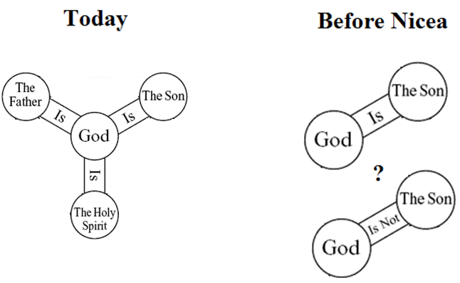
The Council of Nicea – 325 CE

Slide 169
The Council of Nicea – 325 CE
The Council of Nicea had three points of view represented at the meeting: the strict Arians, the semi-Arians and the strict Trinitarians.

Slide 170
The Council of Nicea – 325 CE
The strict Arians were a small minority who were led by Arius.
The strict Trinitarians were also a small minority, they were led by Athanasius.
The vast majority in attendance, however, took a middle position between Arianism and Trinitarianism. They rejected the idea that the Father, Son, and Holy Spirit are of the same substance.

Slide 171
The Council of Nicea – 325 CE
This is further evidence that the Trinity was not the orthodox position of the early Church, since the majority of attending bishops did not hold to a pro-Trinitarian view before the council.

Slide 172
The Council of Nicea – 325 CE
The attendees of the meeting fiercely debated for over two months.
During the Council proceedings, Emperor Constantine himself proposed a pro-Trinitarian, anti-Arian clause into the official creedal statement of the Church.

Slide 173
The Council of Nicea – 325 CE
Faced with the awe-inspiring presence of the emperor, there could be little opposition: the majority of the bishops at the council ultimately agreed upon a creed, known thereafter as the “Nicene creed”.

Slide 174
The Council of Nicea – 325 CE
When the creed was finished eighteen Bishops still opposed it.
Constantine at this point intervened to threaten with exile anyone who would not sign for it.
Two Libyan Bishops and Arius still refused to accept the creed. All three were exiled [6].

Slide 175
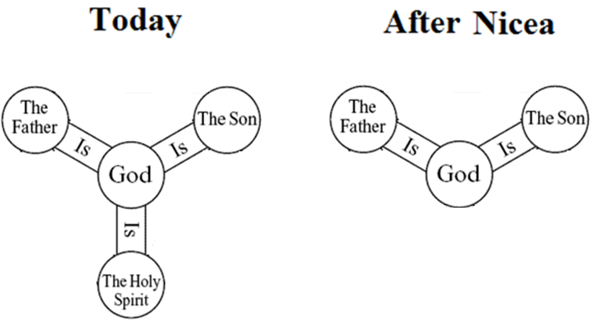
The Council of Nicea – 325 CE

Slide 176
The Councils of Rimini and Seleucia – 359 CE
The Council of Nicea however did not end the controversy, as many bishops disputed the Nicene creed.

Slide 177
The Councils of Rimini and Seleucia – 359 CE
In 359 CE the Emperor Constantius, the son of Constantine, summoned two councils, one in the East at Seleucia and the other in the West at Rimini.
These councils were attended by more bishops than at Nicea and were thus more representative of the entire Church.

Slide 178
The Councils of Rimini and Seleucia – 359 CE
Like his father Constantine before him, Constantius also involved himself in the council proceeding, exerting pressure on the attending bishops.
An anti-Trinitarian, pro-Arian creed was adopted, and thus Arianism became Orthodoxy in the Church.

Slide 179
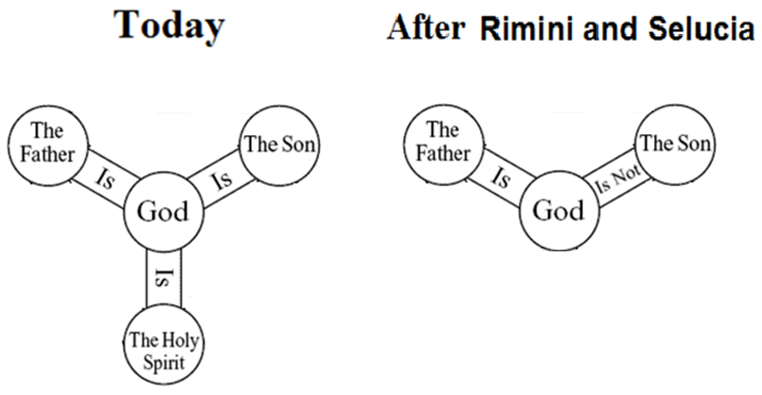
The Councils of Rimini and Seleucia – 359 CE

Slide 180
The Council of Constantinople - 381 CE
The seeming triumph of Arianism was short lived. In 381 CE the Council of Constantinople was summoned by the emperor Theodosius I.
The main business of the council was to re-establish the doctrine that had been set forth in the Nicene Creed.

Slide 181
The Council of Constantinople - 381 CE
This council “sealed the final adoption of the faith of Nicea by the entire Church.” [7].
And so the Nicene Creed first set out at the Council of Nicea 55 years earlier was ultimately victorious over Arianism in the end.

Slide 182
The Council of Constantinople - 381 CE
One specific area where this Council developed the Trinity doctrine was in regard to the Holy Spirit.

Slide 183
The Council of Constantinople - 381 CE
The council attributed four things to the Holy Spirit:
A divine title, ‘Lord’.
Divine functions such as inspiring prophets.
An origin from the Father not by creation but by procession.
Supreme worship equal to that rendered to Father and to the Son.

Slide 184
The Council of Constantinople - 381 CE
Thus the Holy Spirit was voted as the third Person of the Trinity. The Catholic Church admits:
The apostolic faith concerning the Spirit was announced by the second ecumenical council at Constantinople (381) [8]

Slide 185
The Council of Constantinople - 381 CE
At the close of the Council, Emperor Theodosius issued an imperial decree outlawing Arianism.
Thus Arianism was extinguished not by the force of Scriptural truth, but by the force of Imperial involvement.

Slide 186
The Council of Constantinople - 381 CE
After over 55 years of battle, the Nicene Creed permanently gained the upper hand and Trinitarianism became the official doctrine of the Roman Catholic Church.

Slide 187
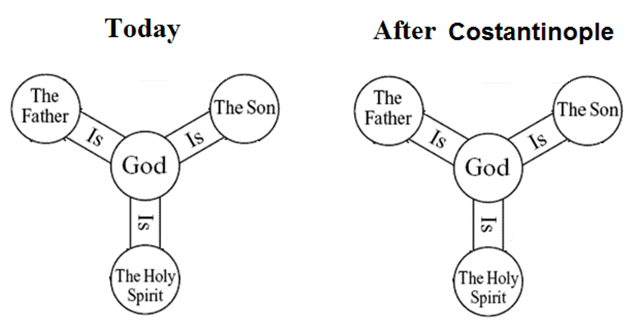
The Council of Constantinople - 381 CE

Slide 188
The Council of Chalcedon - 451 CE
Even after Arianism was defeated, debate raged on about the nature of the incarnate Jesus as he walked upon the earth.

Slide 189
The Council of Chalcedon - 451 CE
While the Council of Nicea focused on the precise relationship of the Son to God the Father, the question that now had to be settled was:
“Did Jesus have a single nature, a mixture of human and divine, or a dual nature – human and divine, both distinct and not blurred together?”

Slide 190
The Council of Chalcedon - 451 CE
This concept of a dual human and divine nature in the person of Jesus became official doctrine of the Church.
Known as the Hypostatic Union, it is as essential component of modern Trinitarianism.

Slide 191
The Council of Chalcedon - 451 CE
It wasn’t until the Council of Chalcedon that we see the emergence of an official doctrine of the Trinity in a form that is recognisable with what Trinitarians believe in today.
This took place in the fifth century, over 400 years after Jesus:

Slide 192
The Council of Chalcedon - 451 CE
“We, then, following the holy Fathers, all with one consent, teach men to confess one and the same Son, our Lord Jesus Christ, the same perfect in Godhead and also perfect in manhood; truly God and truly man... acknowledged in Two Natures unconfusedly, unchangeably, indivisibly…”

Slide 193
What About the Trinity Today?
Even after centuries of discussion and debate, there is still major disagreement among Trinitarians over the doctrine.
Let’s look at some issues...

Slide 194
Issue #1 – The Holy Spirit
As we’ve seen, the equality of the Holy Spirit with the Father and the Son was established at the Council of Constantinople in 381 CE.
While it concluded that the Holy Spirit proceeded from the Father, it said nothing concerning the procession of the Holy Spirit from the Son.

Slide 195
Issue #1 – The Holy Spirit
Here is the last section of the Creed of the Council of Constantinople:
And in the Holy Spirit, the Lord, the giver of life, who proceeds from the Father, who with the Father and the Son is adored and glorified.
This section of the creed was later translated into Latin with the addition, “and the Son”:
And in the Holy Spirit, the Lord, the giver of life, who proceeds from the Father and the Son, who with the Father and the Son is adored and glorified.

Slide 196
Issue #1 – The Holy Spirit
This addition to the creed is known as the Filioque (Latin for “and the Son”), a phrase that has been the subject of great controversy between Eastern and Western churches.
Whether one includes that phrase, and exactly how the phrase is translated and understood, can have important implications for how one understands the Trinity.

Slide 197
Issue #1 – The Holy Spirit
The Western Churches believe that the Holy Spirit proceeds from both the Father and Son.
The Eastern Churches believe that it proceeds from the Father only.

Slide 198
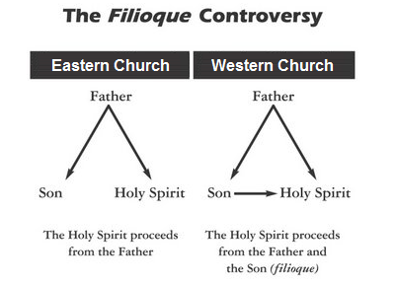
Issue #1 – The Holy Spirit

Slide 199
Issue #1 – The Holy Spirit
This issue is responsible for the largest schism in Church history. It divided Christianity into Western Catholicism and Eastern Orthodoxy.
The Eastern Orthodox reject the Filioque because it makes the Holy Spirit a subordinate, or less important, member of the Trinity. Thus it compromises the co-equality of the Persons of the Trinity.

Slide 200
Issue #2 - The Crucifixion
Who suffered and died on the cross, God or man?

Slide 201
Issue #2 - The Crucifixion
If they claim God died, then this contradicts the Bible which states that God is immortal:
I lift my hand to heaven and solemnly swear: As surely as I live forever. [Deuteronomy 32:40]
who alone is immortal and who lives in unapproachable light, whom no one has seen or can see. [1 Timothy 6:16]

Slide 202
Issue #2 - The Crucifixion
This is why many Christians believe that it was the man that suffered and died, as the crucifixion is only meaningful with reference to his human nature, you cannot crucify the divine nature.
In doing so, Christians separate the divine nature from the human nature at the crucifixion.

Slide 203
Issue #2 - The Crucifixion
This, however, violates the Chalcedon Creed. Recall:
“... acknowledged in Two Natures unconfusedly, unchangeably, indivisibly…”

Slide 204
Issue #2 - The Crucifixion
Thus believing in one essential doctrine, the death of the man Jesus, violates another, the Trinity, because it separates his two natures that are supposed to be eternally united.
Christians are forced to commit these heresies in their defences of the Trinitarian understanding of God.

Slide 205
Issue #2 - The Crucifixion
Can such doctrinal confusion be God’s perfect revelation, or is it the fallible work of man?

Slide 206
Issue #2 - The Crucifixion
Today such confusion is rampant throughout Christian doctrine. This problem of holes appearing in one area of theology in light of other areas is a sure sign of human tampering of the religion.

Slide 207
Some Reflections

Slide 208
1. Doctrinal Evolution
The Trinity doctrine as it is believed in today did not emerge as the official doctrine of the Church until the fifth century — over 400 years after Jesus.
Even after centuries of formulating the doctrine, there is still major disagreement among Trinitarians.

Slide 209
2. Influence of Politics and Philosophy
The doctrine did not come into the Church easily, but rather through a great deal of dispute.
The debate were not dominated solely by scriptural discussion; politics and philosophy played significant roles.

Slide 210
3. Imperial Interference
Imperial involvement in the controversy determined at any given moment whether Trinitarianism or Arianism was dominating the controversy.
This must be a sobering thought, that the Nicene Creed won in the end is almost an accident of history. If Constantine or any subsequent emperors had favoured Arianism, then Arianism could be the official position of the Church today!

Slide 211
Tawheed
By comparison, Tawheed underwent no such historical evolution.
The entire Muslim creed was finalised during the lifetime of Prophet Muhammad (pbuh):
This day I have perfected for you your religion and completed My favour upon you and have approved for you Islam as religion… [5:3]

Slide 212
Tawheed
Anyone that tries to introduce something new into Islam is rejected.
This is the strict standard that Muslim scholars have held to since the beginning. These strict standards have been built into the religion since its inception, preserving the purity of Tawheed:
The tribes of Israel broke up into seventy-two sects. My ummah [nation] shall break up into seventy-three sects. All of them will be in the Fire except for one: [That group] which follows what I and my Companions are following. [at-Tirmidhi]

Slide 213
Progress

Slide 214
Finality of Jesus

Slide 215
Finality of Jesus
Christians believe that Jesus completed God’s plan of salvation for mankind.
No more Prophets/Messengers after him.

Slide 216
Christians place a big emphasis on looking to the Old Testament for signs/prophecies about the coming of Jesus.
In Matthew’s Gospel alone there are over 80 prophecies about Jesus quoted from the Old Testament.

Slide 217
As well as prophesying about the coming of the Messiah Jesus, the Old Testament also foretells the coming of an Arabian messenger that could only be Muhammad (pbuh).

Slide 218
We can use the 42nd chapter of the Book of Isaiah to prove to them that the Bible points to the coming of Prophet Muhammad (pbuh).

Slide 219
Isaiah 42 is a Prophecy
The 42nd chapter of the Book of Isaiah describes itself as a prophecy about the future. Isaiah states that:
…the former things have taken place, and new things I declare... [Isaiah 42:9]

Slide 220
His names
Isaiah starts the chapter by drawing our attention to a very special person that God will send. He describes this person as:
…my servant, whom I uphold, my chosen one in whom I delight... [Isaiah 42:1]
It’s interesting that at least three of the descriptions relate to names of Prophet Muhammad (pbuh) – “servant”, “chosen one” and “in whom I delight”.

Slide 221
His names
Prophet Muhammad is known as God’s Servant, in Arabic “abd - ullah”.
“Chosen one” is “Mustafa” in Arabic. This is another of the names of Prophet Muhammad.
The one in whom God ‘delights in’ shows that this person is beloved to God. ‘Habibullah’ in Arabic, which means “Beloved of God”, also happens to be one of Prophet Muhammad’s names.

Slide 222
His location
Isaiah also reveals the location of this special person. He states:
Let the wilderness and its towns raise their voices; let the settlements where Kedar lives rejoice. Let the people of Sela sing for joy; let them shout from the mountaintops. [Isaiah 42:11]

Slide 223
His location
The two key words used are ‘Kedar’ and ‘Sela’ which together pinpoint an exact location for this special person.
Out of all the places on earth that Isaiah mentioned, he chose to highlight Kedar and Sela’s location so we should pay special attention.

Slide 224
Who is Kedar?
The Old Testament tells us that Kedar was one of the sons of Ishmael:
These are the names of the sons of Ishmael, listed in the order of their birth: Nebaioth the firstborn of Ishmael, Kedar, Adbeel, Mibsam [Genesis 25:13]

Slide 225
Kedar in the desert of Arabia
We are informed that Ishmael dwelt in a place called Paran:
While he (Ishmael) was living in the Desert of Paran, his mother got a wife for him from Egypt. [Genesis 21:21]

Slide 226
Kedar in the desert of Arabia
Many Christian interpreters of the Bible hold that Paran is in Arabia. From Clarke’s Commentary on the Bible:
He dwelt in the wilderness of Paran – This is generally allowed to have been a part of the desert belonging to Arabia Petraea, in the vicinity of Mount Sinai; and this seems to be its uniform meaning in the sacred writings.
Moreover Strong’s Bible Dictionary also tells us:
H6290 pâ’rân From H6286; ornamental; Paran, a desert of Arabia: – Paran.

Slide 227
Kedar in the desert of Arabia
Kedar and his own sons are also specifically linked to Arabia:
Arabia and all the princes of Kedar were your favored dealers in lambs, rams, and goats; in these they did business with you. [Ezekiel 27:21]

Slide 228
Sela Mountain is in Madinah
Whilst it’s true that Arabia represents a wide geographic region, the use of the word ‘Sela’ pinpoints an exact location.
“...let the settlements where Kedar lives rejoice. Let the people of Sela sing for joy...”

Slide 229
Sela Mountain is in Madinah
The place being spoken of is actually the city of Madinah because ‘Sela’ is the name of a famous mountain in Madinah. Madinah was the city of Prophet Muhammad (pbuh):

Slide 230
Sela Mountain is in Madinah

Slide 231
Sela Mountain in Hadith
This mountain is mentioned in hadith:
“…by Allah, we did not see any cloud or any patch of it, and there was neither any house or building standing between us and Sala’…” [Muslim, Chapter 169, Hadith 1955]

Slide 232
Muhammad (pbuh) a Descendent of Kedar
It is worth mentioning that from Islamic sources, Prophet Muhammad’s lineage can be traced back to Abraham through Kedar:

Slide 233
Muhammad (pbuh) a Descendent of Kedar

Slide 234
The Jewish Tribes of Madinah
Islamic history records the fact that whenever a dispute arose between the Jews and Arabs in Madinah, they used to taunt their pagan Arab neighbours, by saying that:
“when our prophet arrives we shall obliterate you…” [Seerah of Ibn Hisham]

Slide 235
The Jewish Tribes of Madinah
Now we can understand how the Jewish tribes knew that Muhammad (pbuh) would appear in the locality of Madinah!
The answer is that the learned Jews were aware of this prophecy in Isaiah and were anxiously awaiting the coming of a new prophet.

Slide 236
Who he will be sent to
Isaiah emphasises the universal mission of the coming person by mentioning that he will be made a:
...covenant for the people and a light for the Gentiles [Isaiah 42:6]
Gentiles means non Jews. The Qur’an confirms that Prophet Muhammad (peace be upon him) was sent to the whole of mankind, Jews and Gentiles alike. In the Qur’an God tells us:
We have sent you [O Prophet] as a bearer of glad tidings and a warner for the whole of mankind, but most people have no knowledge. [34:28]

Slide 237
Who he will be sent to
Isaiah further states that God will:
…lead the blind by ways they have not known, along unfamiliar paths I will guide them... [Isaiah 42:16]

Slide 238
Who he will be sent to
The pagan Arabs at the time of Prophet Muhammad fit this description perfectly because they had not been sent a messenger prior to Muhammad (pbuh).
The Qur’an bears witness to this, God states that Muhammad was sent to:
... warn a people to whom no warner has come before... [32:3]

Slide 239
Isaiah emphasises that this special person will be sent to:
...those who trust in idols, who say to images, ‘You are our gods,’... [Isaiah 42:17]
The whole of Arabia at the start of Muhammad’s Prophethood consisted of idol worshippers.

Slide 240
He will be a warrior
Isaiah states that this special person will be a warrior and will:
...go forth as a mighty man, he shall stir up jealousy like a man of war: he shall cry, yea, roar; he shall prevail against his enemies. [Isaiah 42:13]
Throughout history God has dealt sternly with those who are sent guidance and persist in disbelief. Prophet Muhammad (pbuh) had to engage in many battles with the idol worshipping enemies of God and ultimately prevailed against them.

Slide 241
What he will achieve
Isaiah gives us a list of momentous achievements for this special person. Chief of these is that the idol worshippers:
...will be turned back in utter shame... [Isaiah 42:17]
Not only did Prophet Muhammad conquer Makkah, the Pagan capital of Arabia, but by the end of his life, in just 23 short years of Prophethood, Arabia had shunned idol worship and now worshipped the One true God.

Slide 242
A warning from God
Finally, Isaiah closes with an admonishment:
“Hear, you deaf; look, you blind, and see…
You have seen many things, but you pay no attention; your ears are open, but you do not listen…
Which of you will listen to this or pay close attention in time to come?” [Isaiah 42:18-23]
Are the “deaf and blind” Isaiah is talking about in these verses, those of the People of the Book who reject Prophet Muhammad (pbuh)?

Slide 243
How Christians Interpret Isaiah 42
They may try to argue that Isaiah 42 is a reference to Jesus.
Can this be the case?

Slide 244
Kedar and Sela Rules Out Jesus
Recall the location mentioned by Isaiah:
Let the wilderness and its towns raise their voices; let the settlements where Kedar lives rejoice. Let the people of Sela sing for joy; let them shout from the mountaintops. [Isaiah 42:11]
What link does Jesus have to the deserts of Arabia and Sela mountain? Moreover the vast majority of Arabia today is Muslim, Christians account for only a small percentage.

Slide 245
War Language Rules Out Jesus
Recall that this person will be a warrior who will:
...go forth as a mighty man, he shall stir up jealousy like a man of war: he shall cry, yea, roar; he shall prevail against his enemies. [Isaiah 42:13]

Slide 246
War Language Rules Out Jesus
Jesus did not triumph over his enemies, according to Christians he was crucified by them. Moreover Jesus wasn’t interested in fighting, he was not a man of war, he was a pacifist according to the New Testament. He said such things as:
“for all who draw the sword will die by the sword.” [Matthew 26:52]
“My kingdom is not of this world: if my kingdom were of this world, then would my servants fight…” [John 18:36].

Slide 247
Defeating Idolaters Rules Out Jesus
Recall that Isaiah mentions idolatry being defeated:
But those who trust in idols, who say to images, ‘You are our gods,’ will be turned back in utter shame. [Isaiah 42:17]
This cannot be a reference to Jesus because his people, the Israelites, were monotheists and not idol worshippers.
Moreover Christianity did not become widely accepted by the pagan Gentiles (non-Jews) until the Roman Empire embraced the religion in the 4th century, over 300 years after Jesus.

Slide 248
Further Reading
TRINITY

Slide 249
References
1 - Catechism of the Catholic Church, no. 234.
2 - Harold Lindsell and Charles Woodbridge, A Handbook of Christian Truth, pp. 51-52.
3 - The Catholic Encyclopedia, “De pud.”, xxi.
4 - Justin Martyr, The First Apology, Chapter 21.
5 - Tertullian, Against Praxeas, chapter 9 – The Catholic Rule of Faith Expounded in Some of Its Points. Especially in the Unconfused Distinction of the Several Persons of the Blessed Trinity.
6 - Richard E. Rubenstein, When Jesus Became God, p. 83.
7 - The New Catholic Encyclopedia, 1967, Vol. 1. Arianism, by V.C. Declercq, p. 793.
8 - Catechism of the Catholic Church. Imprimatur Potest, Joseph Cardinal Ratzinger. Doubleday, p. 72.

